Slide 1

PROJECT PRESENTATION
OF
E – MANDI
“Healthy India , Wealthy India…”
MASTER OF COMPUTER APPLICATION
SUBMITTED BY
GUIDEDE BY
Mr. Bhaskar Sharma Sir
Vaibhav Thakur Roll no : 2102200140091

Slide 2
INTRODUCTION
E - Mandi is basically based on organic product like fresh vegetables , fruits, pulses and milk .
It is user friendly Web Portal in which a user can easily to buy and sale the products
We are providing many services like to sell and purchase ,online payments and cash on Delivery
By this we can provide fresh and hygienic products to the user\buyer.
The products are delivered to the user by the sellers.

Slide 3
OBJECTIVE
Following are the main objectives that we wish to achieve from
this project
To provide sellers a better environment b which they can reduce their stress by selling vegetables and fruits as a door to door selling.
By this a user get better feel as the goods which are delivered to them are maintained in very hygiene environment .
To provide a platform on which a user can easily get the fresh vegetables and fruits.
The Products which are provided on our web portal are maintained through Quality Assured Parameter which should be maintained by the seller.

Slide 4
SOFTWARE REQUIREMENTS
Operating System : Windows ,Mac or Linux
User Interface : HTML, CSS , Bootstrap
Client-side Scripting : Java Script
Web Applications : JDBC, Servlets, JSP
Database : My SQL
Editor : Java Net Beans

Slide 5
FUNCTIONALITY PERFORMED BY CUSTOMER
CUSTOMER REGISTRATION
CUSTOMER LOGIN
PRODUCT LISTING
PRODUCT DETAIL
CUSTOMER ORDER CONFIRMATION
CHANGE PASSWORD
QUALITY CHECK MODULE
View to seller.
View to buyer.

Slide 6
SYSTEM MODULES
CUSTOMER REGISTRATION MODULE : –
In our web portal if a customer wans to buy products he / she has to register themselves into our application.
As the customer register himself in the web portal he / she has to mention that he / she is a consumer or a seller.
After the registration the persion can be able to place their order in our web portal.
CUSTOMER LOGIN MODULE : –
After the completion of registration process a consumer and a seller is able to login their account .
By this a user can save his / her information regarding orders and delivery details.

Slide 7
SYSTEM MODULES
PRODUCT LISTING MODULE : –
In this module we have designed format to list or showcase the products that we have on our web portal
By the help of product listing a user can easily find that he / she wants.
PRODUCT DETAIL MOIDULE : –
In this module we have included the details of the products like their prices.
A details module plats an important role in the web portal as a customer a person wants all details about the product that he / she wants.

Slide 8
SYSTEM MODULES
CUSTOMER ORDER CONFIRMATION MODULE : –
This module is very important as because a customer always wants a confirmation from the web portal that he / she is using .
In this module we are going to develop a conformation page that displays that the order is well placed.
CHANGE PASSWORD MODULE: –
In this module we have included a security phase as to create a password by the user .
A password is very important in any account because a user always wants his / her data to be secured .

Slide 9
SYSTEM MODULES
QUALITY CHECK MODULE :
View to seller :
This module is very important as because a seller have to pass this section to place their product on our web portal
This module is available for the seller to maintain the quality in every week.
QUALITY CHECK MODULE :
View to Buyer :
This module is very important as because a buyer should check the quality of the product before order.
This module is available for the buyer to check the OK sign at Quality .

Slide 10
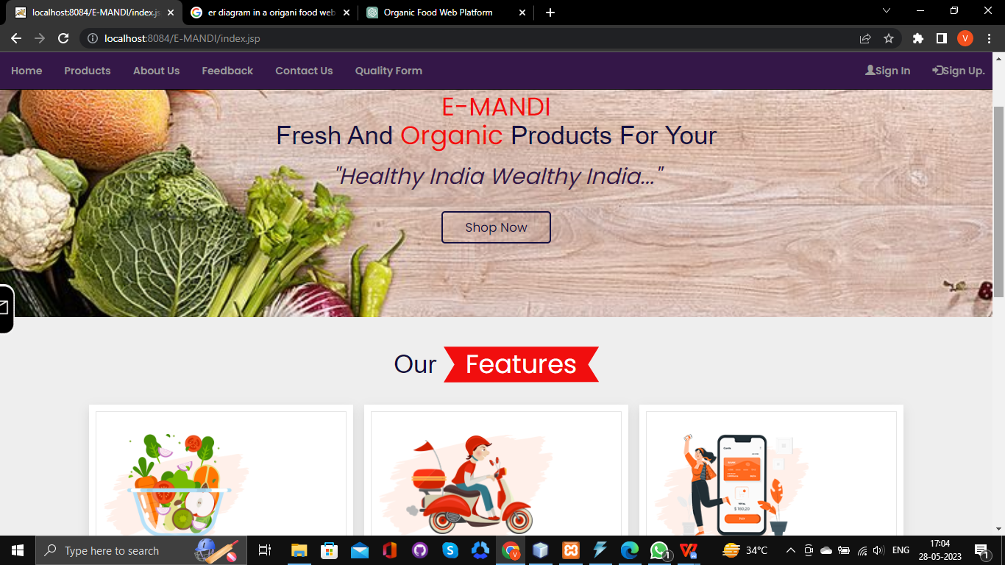
Home Page Screen

Slide 11
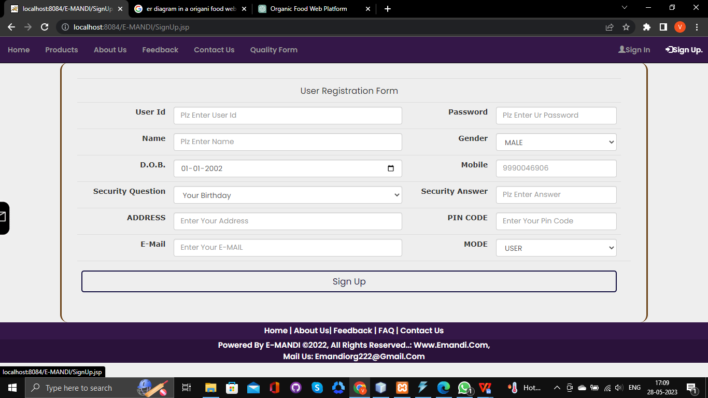
Create Registration Page

Slide 12
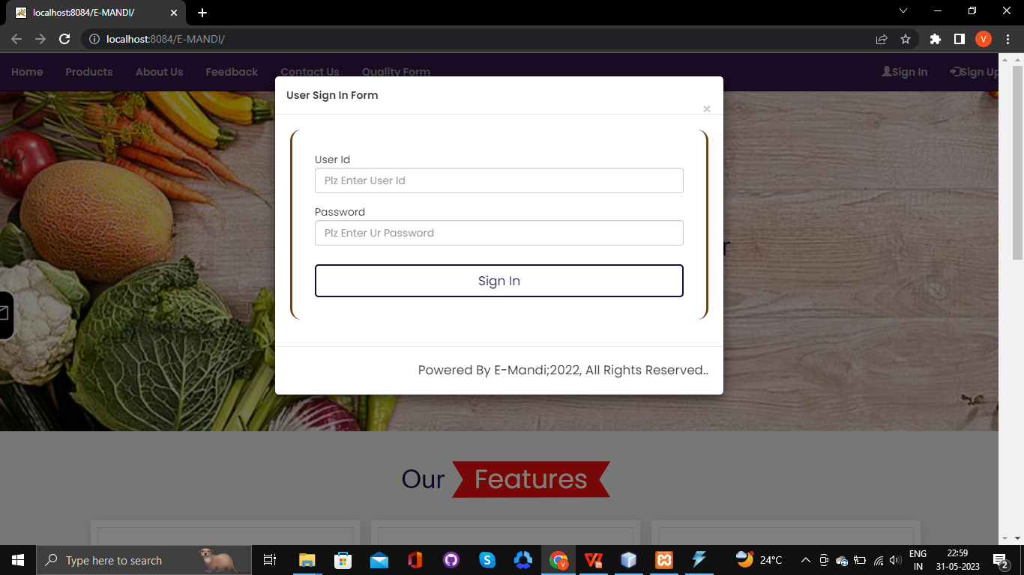
Create Sign in Screen

Slide 13
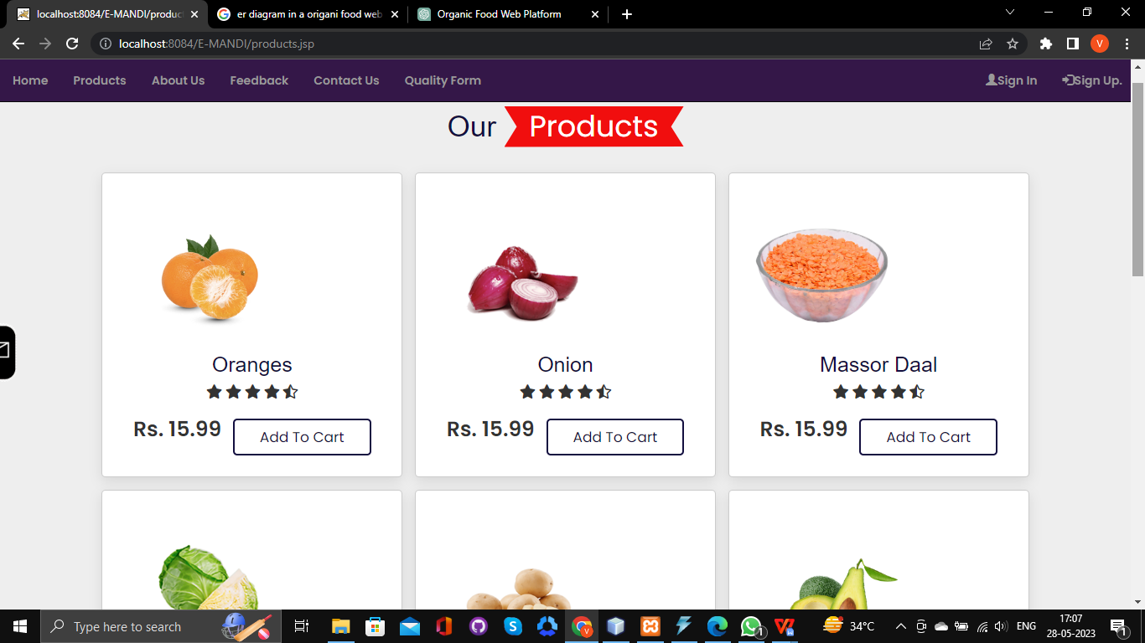
Create Products Page

Slide 14
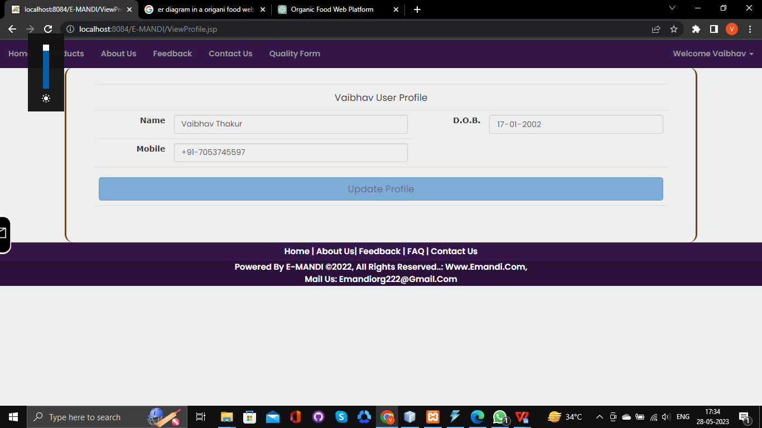
Create User Profile Page

Slide 15
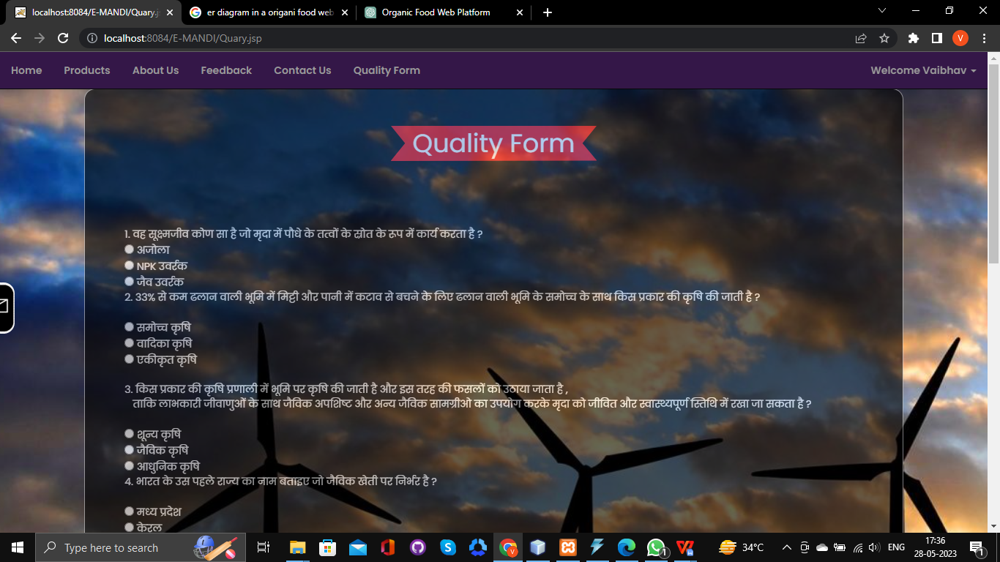
Create Quality Form Page

Slide 16
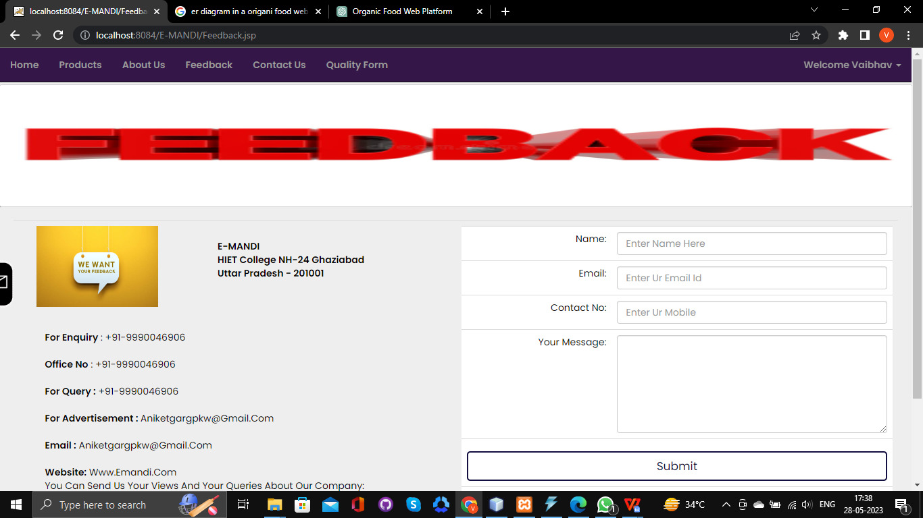
Create Feedback Page Screen

Slide 17
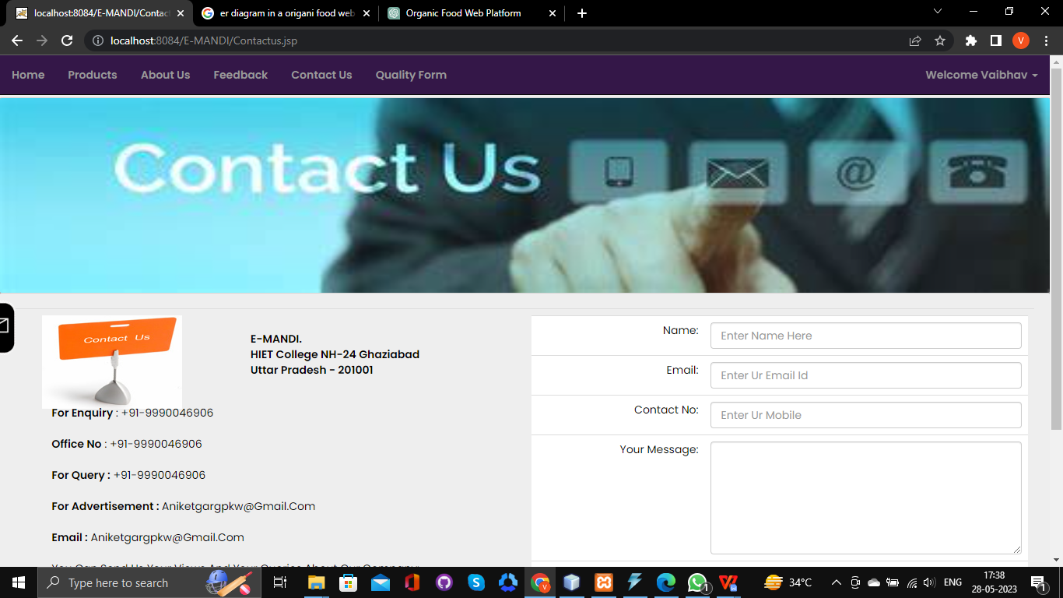
Create Contact us Page Screen

Slide 18
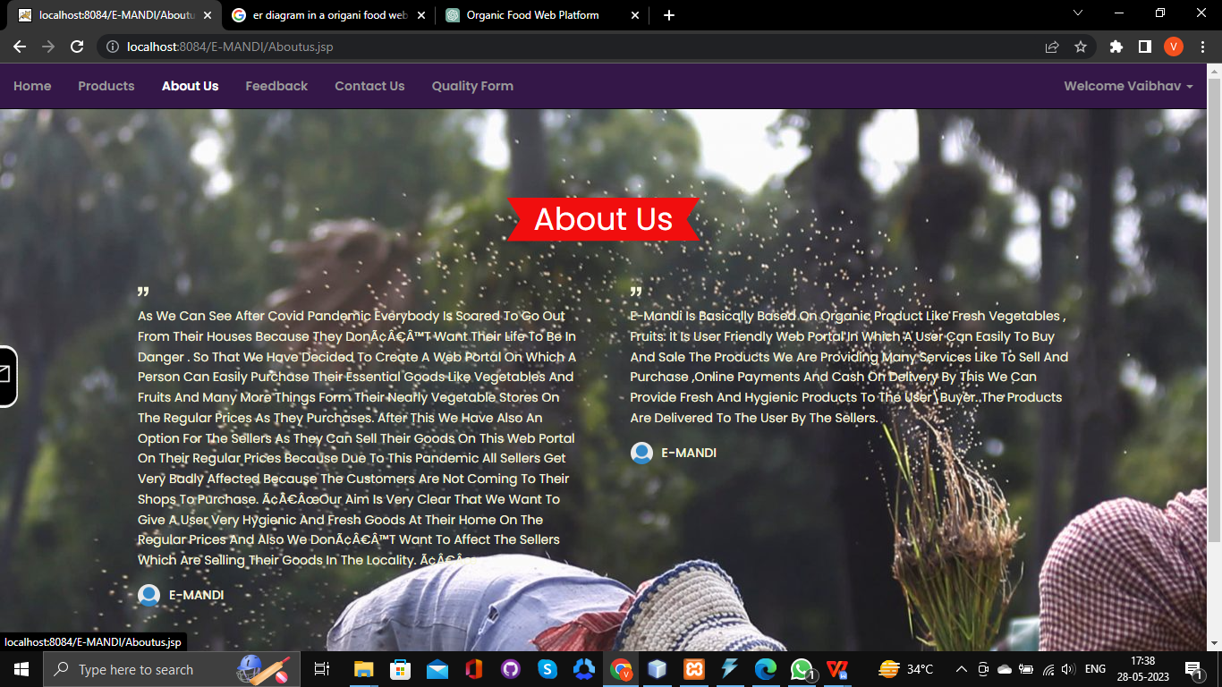
Create About us Page Screen

Slide 19
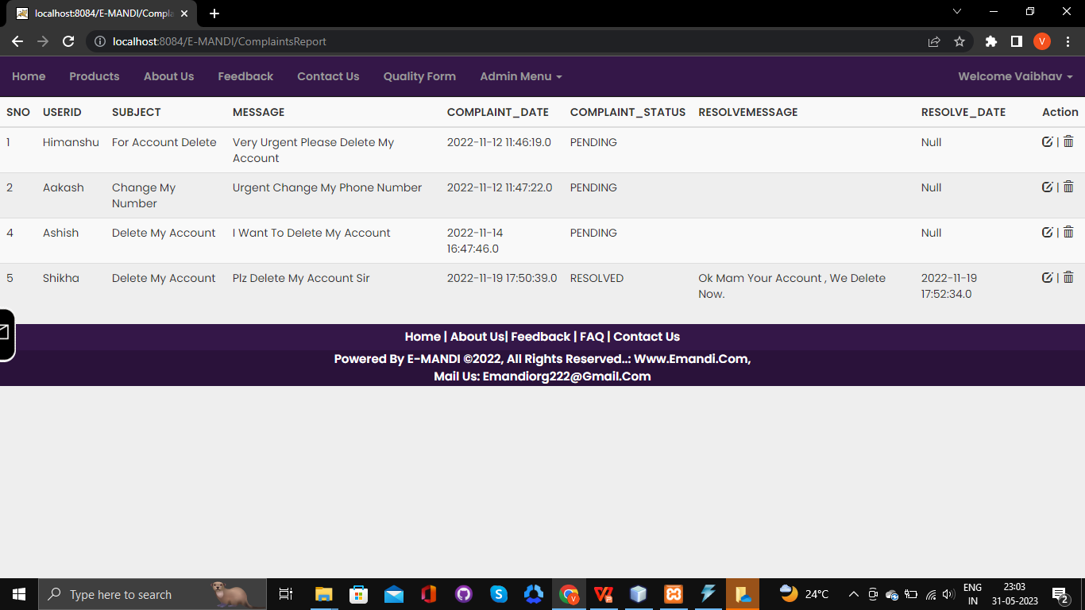
Create Complant solve Screen

Slide 20
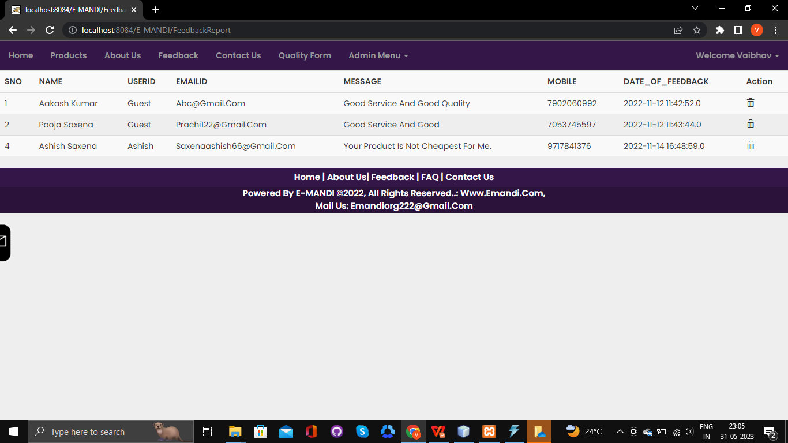
Create Feedback Reply Screen

Slide 21
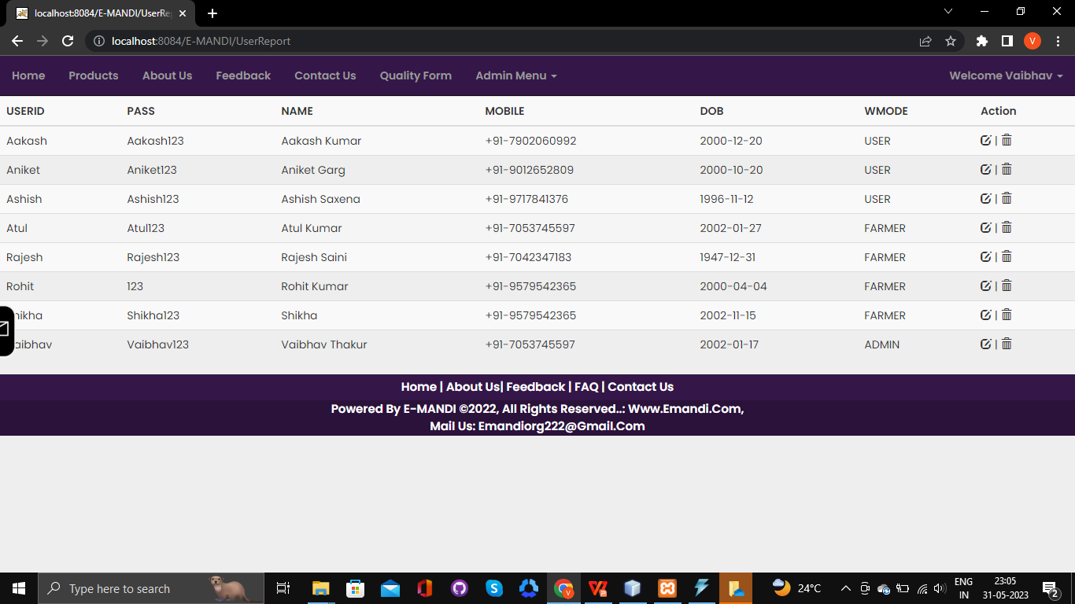
Create List of All User Screen

